Slide 1
Multimodal Video Analysis
Juan Leon-Alcazar
Postdoctoral Fellow IVUL Research Group

Slide 2
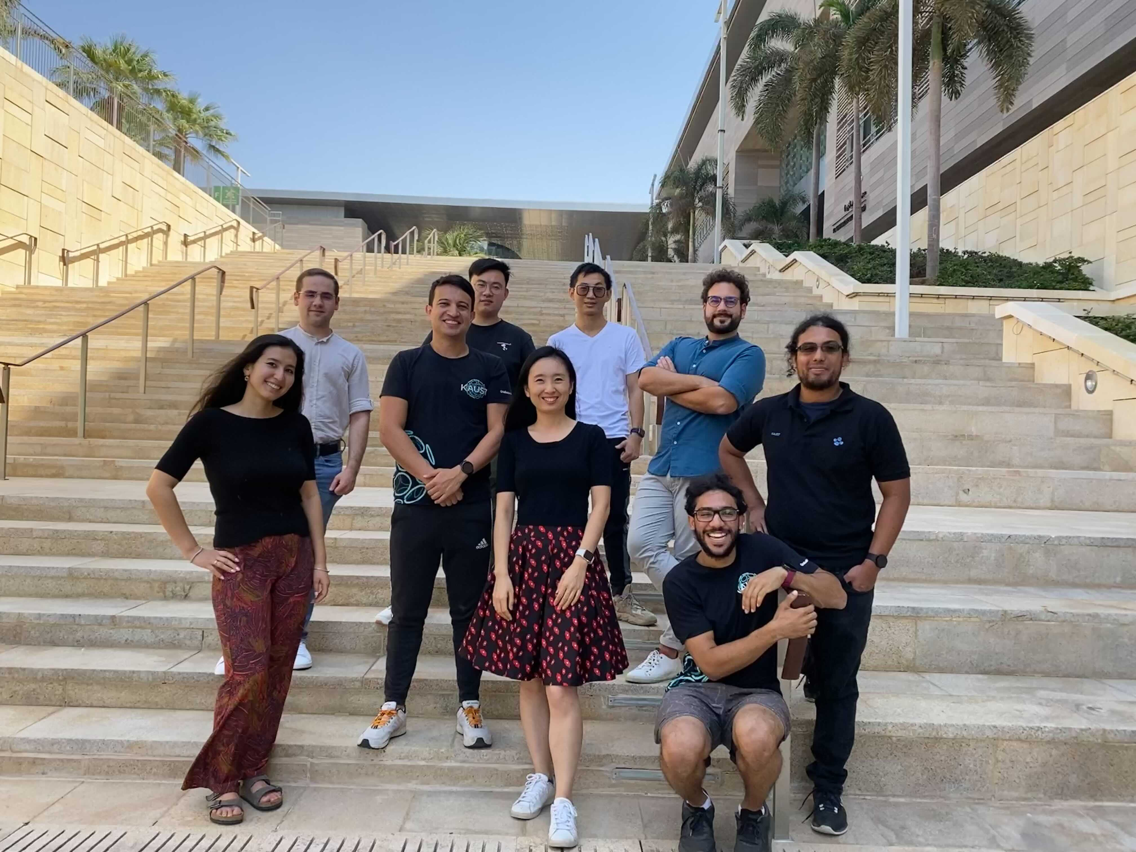
IVUL - Video Analysis
Temporal Action Localization.
Audivisual recognition.
Creative Video.
Video Continual Learning.
Video Language Grounding.
Large Scale Video Pretraining.

Slide 3
IVUL - Video Analysis
Temporal Action Localization.
Audivisual recognition.
Creative Video.
Video Continual Learning.
Video Language Grounding.
Large Scale Video Pretraining.

Slide 4
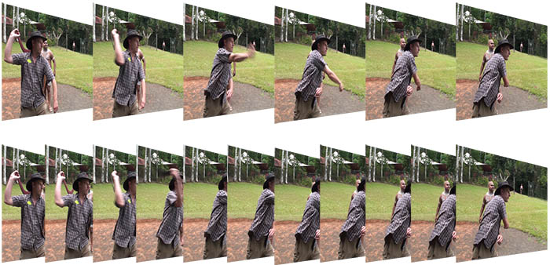
Why Multi-modal data on video?
You already have the added temporal dimension why even bother with extra data?
https://www.mediacollege.com/

Slide 5
Why Multimodal analysis on video?
Video is Inherently multimodal!
Watching a video with feels weird?
Since video is about capturing actions, a language description feels closely related.

Slide 6
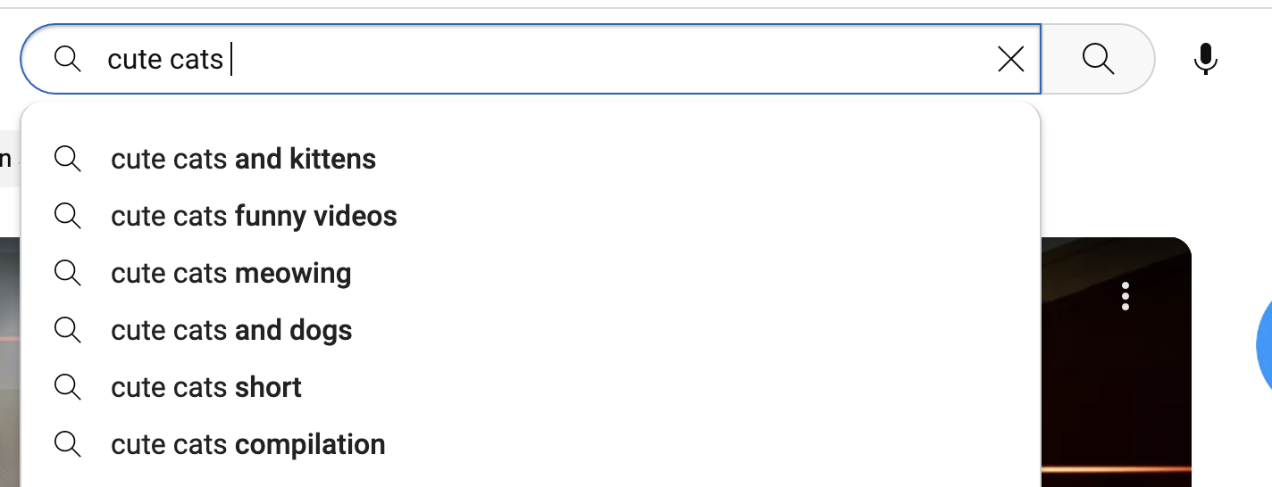
Why Multimodal analysis on video?
Video is Inherently multimodal!
Watching a video with feels weird?
Since video is about capturing actions, a language description feels closely related.

Slide 7
Why Multimodal analysis on video?
Video is Inherently multimodal!
Watching a video with feels weird?
Since video is about capturing actions, a language description feels closely related.
This second modality actually becomes critical in some tasks.

Slide 8
IVUL - Video Analysis
Temporal Action Localization.
Audivisual recognition.
Creative Video.
Video Continual Learning.
Video Language Grounding.
Large Scale Video Pretraining.

Slide 9
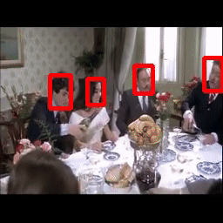
Active Speaker Detection
Identify which of the visible persons in a video is the current speaker (if any).

Slide 10
Active Speaker Detection
Identify which of the visible persons in a video is the current speaker (if any).
Is an inherently multi-modal task as no single modality can provide full supervision to identify the Active Speaker.
Visual data is a fair approximation, but incomplete

Slide 11
Active Speaker Detection
Identify which of the visible persons in a video is the current speaker (if any).
Is an inherently multi-modal task as no single modality can provide full supervision to identify the Active Speaker.
Visual data is a fair approximation, but incomplete
Audio only data can tell us if there is speech in the scene.

Slide 12
Why would you care about ASD?
Video Edition (Offline)
We can now focus on who is speaking at any time.
Is a critical element on Hollywood movies.
It guides the edition process.
Video Conferencing (Online)
Relocate whoever is speaking without needing an array of microphones.

Slide 13
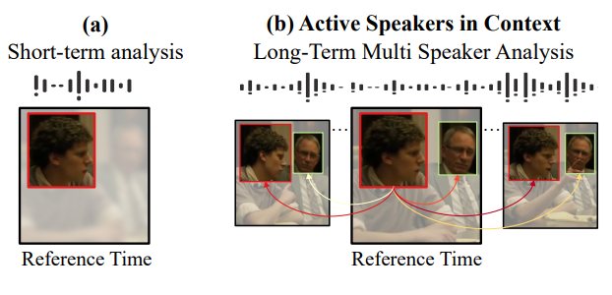
Our Key Idea

Slide 14
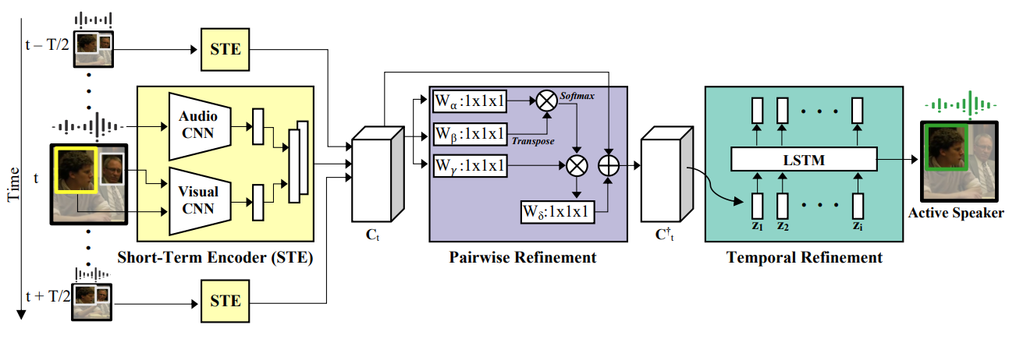
Active Speakers In Context

Slide 15
Active Speakers In Context

Slide 16
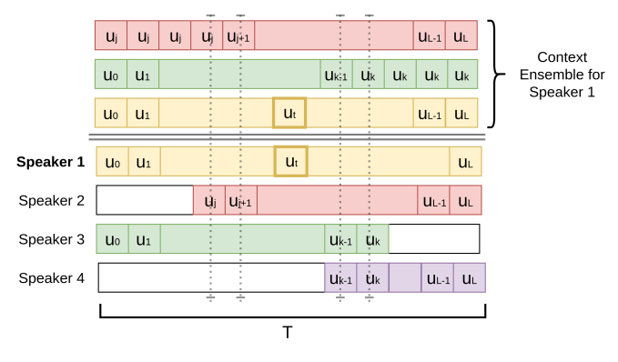
Feature Stack (The Actual Context)

Slide 17
Decoding the Context

Slide 18
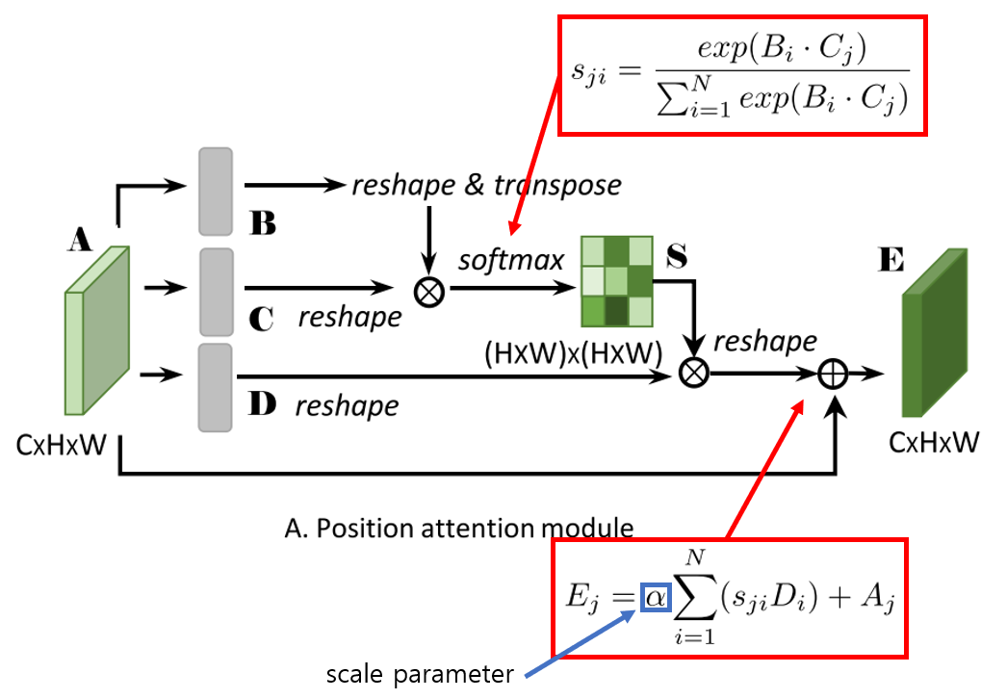
What is the Non-local Block?
We first match every single feature against each other.
The feature similarity is then used to ‘pull’ features from the original sequence.
We make sure the representation of each element is determined by every other element, according to their similarity.
hydragon-cv.info

Slide 19
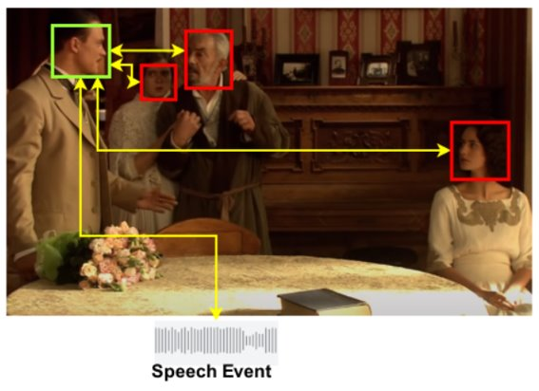
A more Fundamented Approach for ASD
Speech Events must be attributed!
Speech events must be generated by a human.
The only question is what happens with offscreen speech?
Luckily that's not an issue in Hollywood Video!

Slide 20
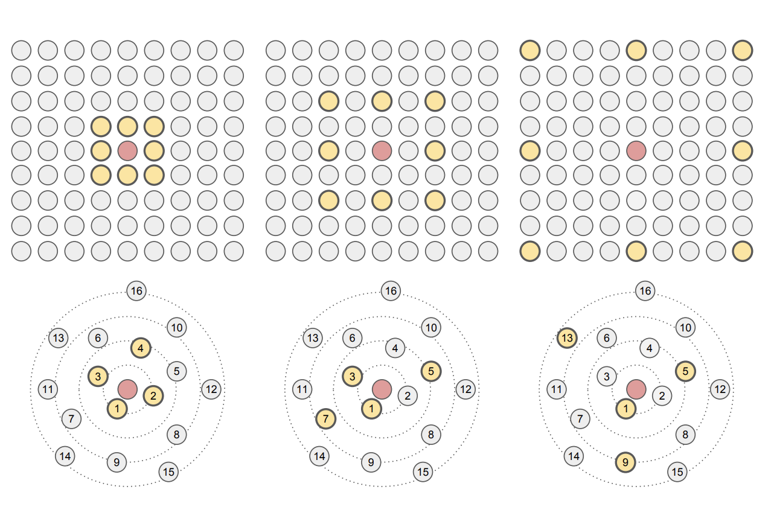
Graph Neural Networks (GNN)
GNNs are the natural extension of
convolutional networks to work with non- Euclidean data
We now define the Neighborhood of the Pixels, and can assign properties to their edges.
Lee et al.

Slide 21
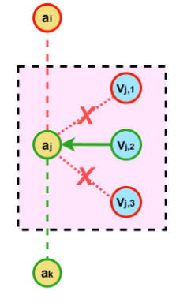
Graph Neural Networks for ASD
We can replace the attention to an explicit Graph network.
We model the affinity between individual video nodes (Cyan) to an audio node.
We can directly establish relationships between Video node (visible persons) and audio nodes (Long term dependencies).

Slide 22
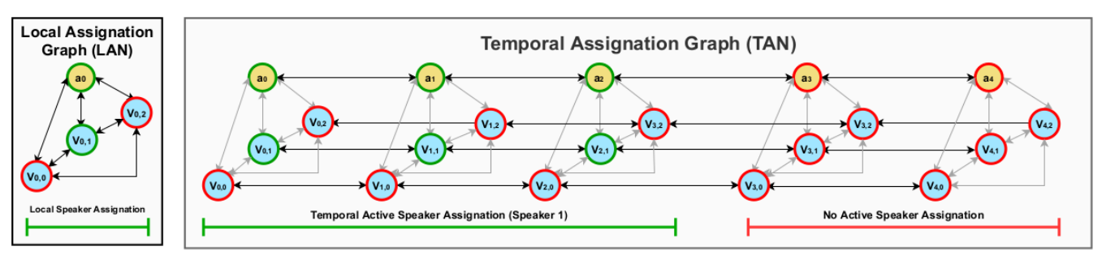
From local to temporal relationships

Slide 23
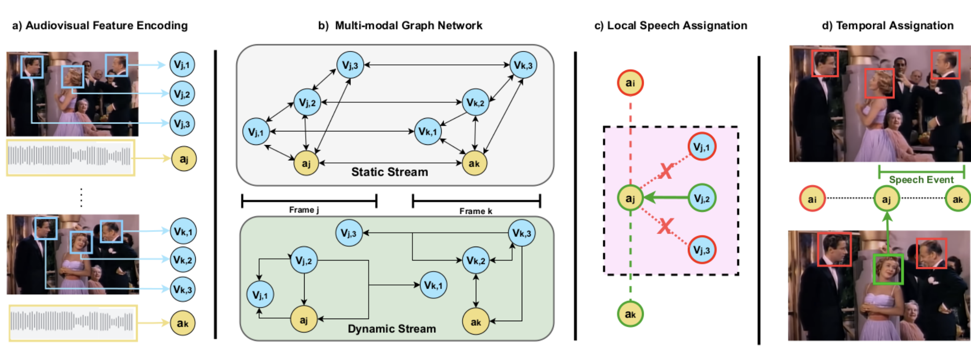
The MAAS architrecture

Slide 24
Video Continual Learning
Deep learning pipelines could require the sequential fine-tuning of large models in a set of independent tasks, if these are learned sequentially Deep neural networks suffer from what is known as catastrophic forgetting.

Slide 25
Video Continual Learning
Deep learning pipelines could require the sequential fine-tuning of large models in a set of independent tasks, if these are learned sequentially Deep neural networks suffer from what is known as catastrophic forgetting.
After learning in dataset "A", and then switching to data "B", our network already forgot everything about "A".

Slide 26
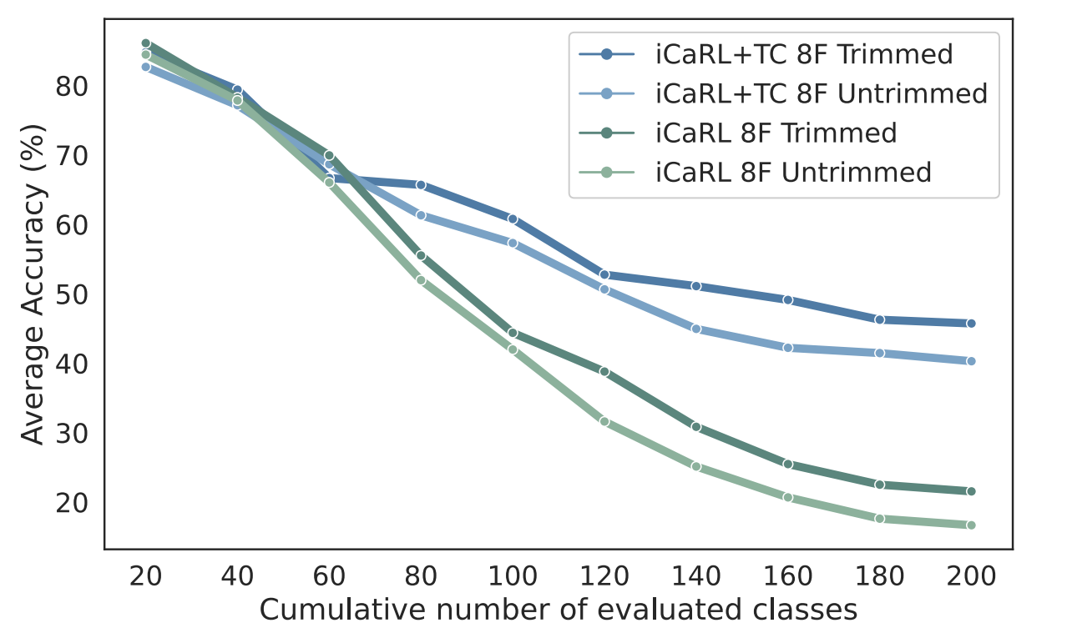
Perfomance Decay Along Consecutive Tasks

Slide 27
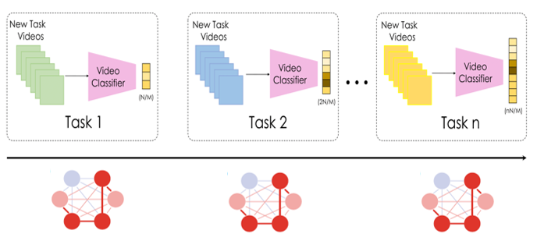
Video Continual Learning
Synaptic plasticity is the ability to establish new synaptic configurations, which is essential to learn new tasks (Transfer Learning).
Synaptic stability is the ability to re-establish or remember the activation patterns needed to solve a task.

Slide 28
Video Continual Learning
Synaptic plasticity is the ability to establish new synaptic configurations, which is essential to learn new tasks (Transfer Learning).
Synaptic stability is the ability to re-establish or remember the activation patterns needed to solve a task.

Slide 29
Common Approaches in CIL
Regularized methods: penalize abrupt changes in the most relevant parameters learned from previous tasks.
Memory-Based methods: mitigate catastrophic forgetting by retaining a limited amount of training instances from previous tasks.

Slide 30
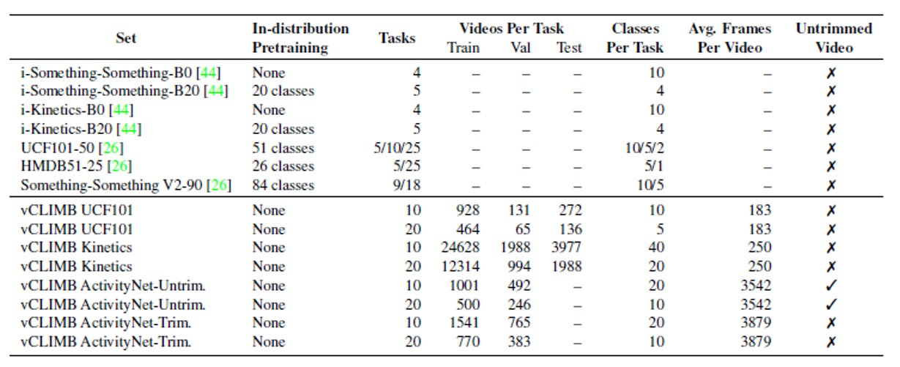
Vclimb: First Video Continual Learning Benchmark

Slide 31
Avoid In-Distribution Pretraining

Slide 32
Untrimmed Video

Slide 33
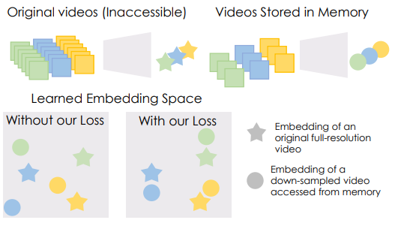
Temporal Consistency for Video CIL
Consistency loss encourages learning representations that are robust to frame sampling, enabling the CIL model to remember old tasks by looking only at down-sampled versions of those videos.

Slide 34
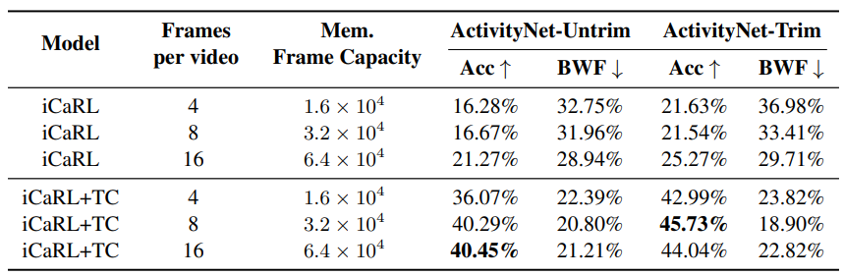
VClimb Results

Slide 35
Where is the multi-modal data?

Slide 36
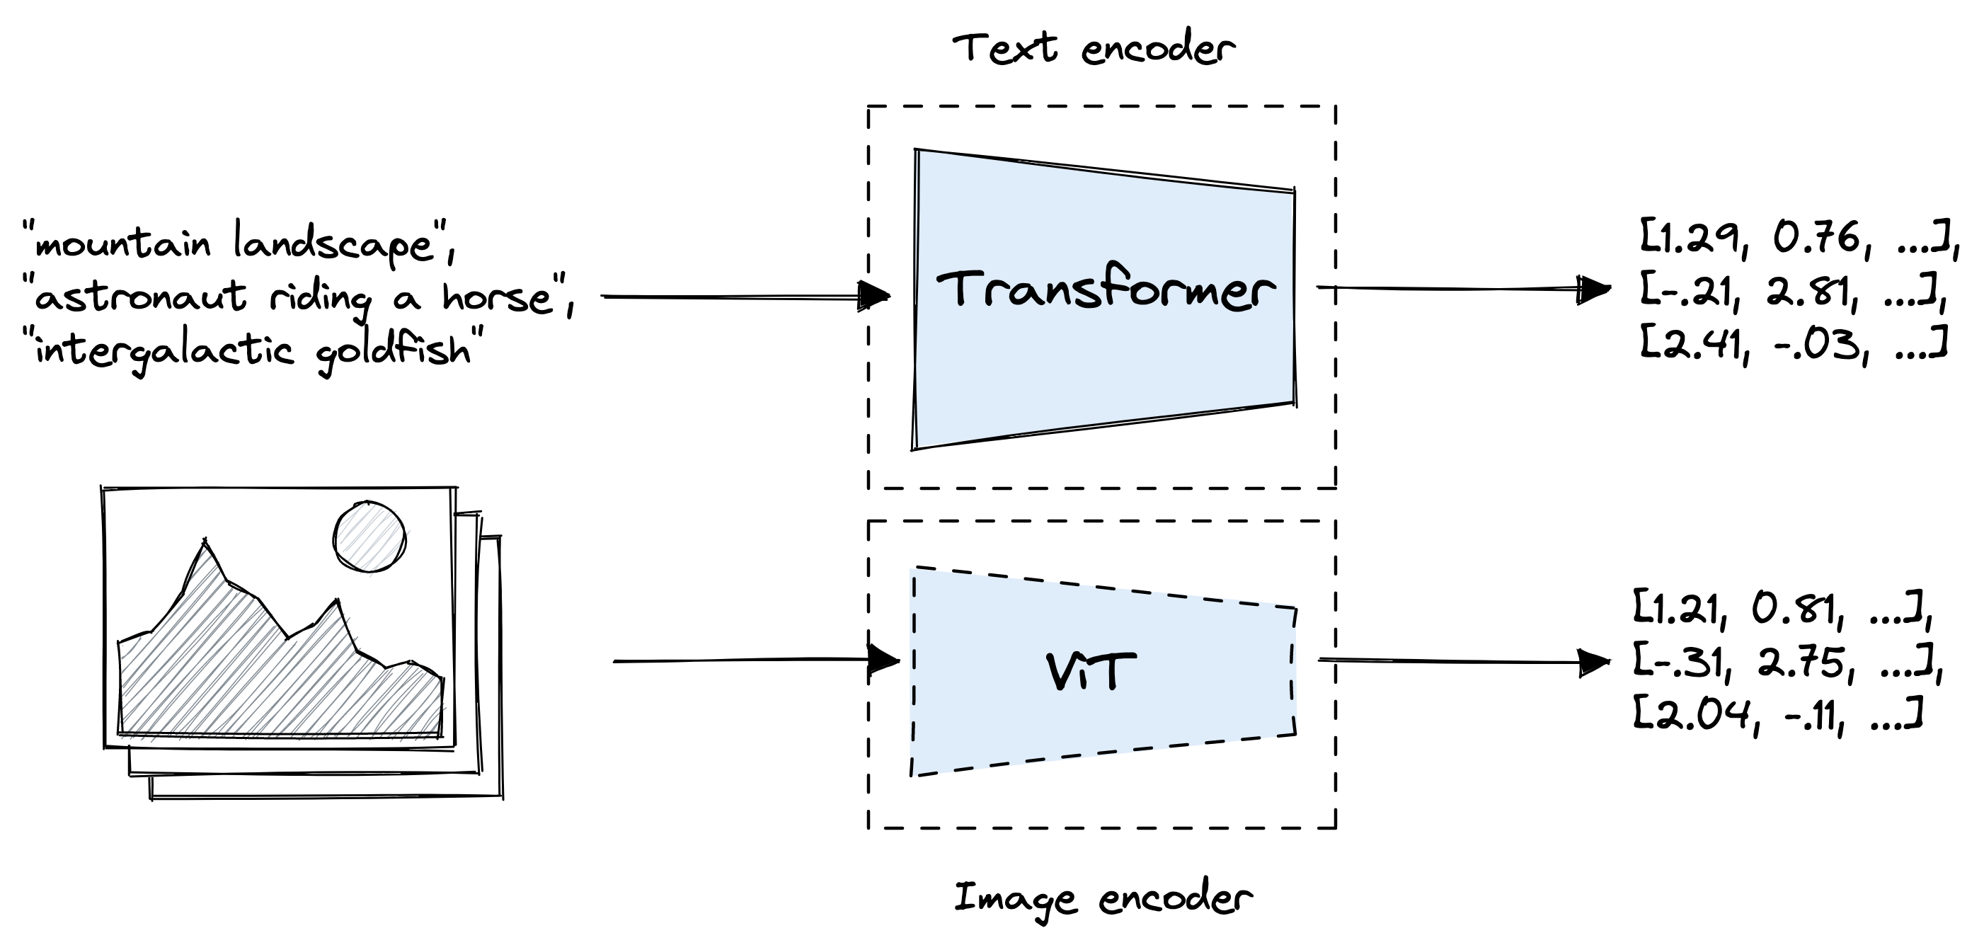
Image and Video “Alignment” (CLIP)
www.pinecone.io

Slide 37
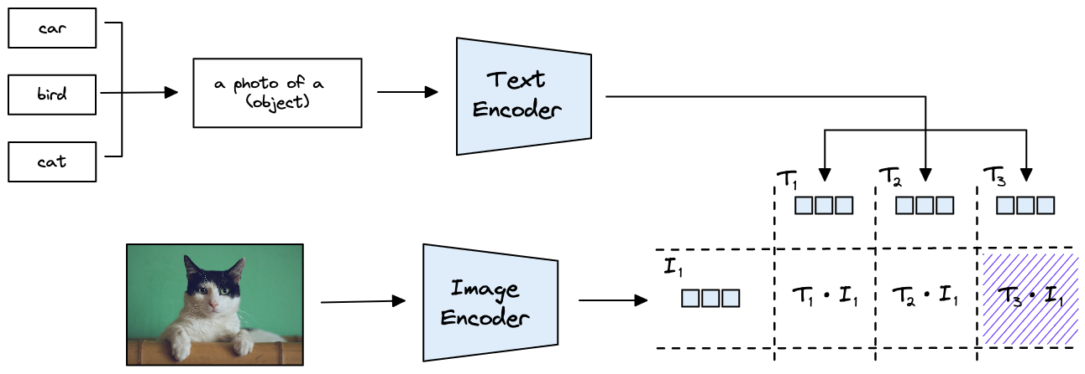
Zero-shot Classification
www.pinecone.io

Slide 38
Zero-shot Classification
www.pinecone.io

Slide 39
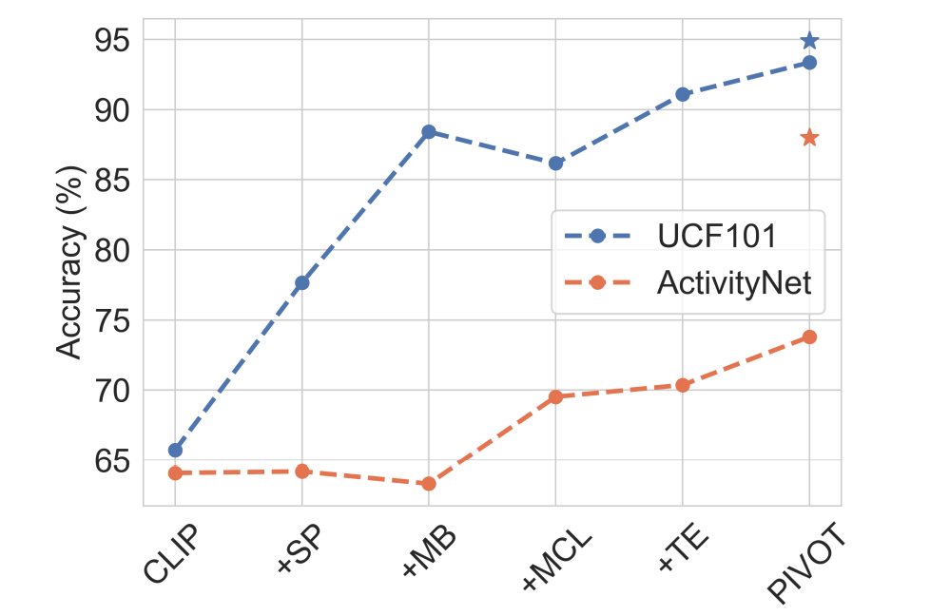
This also Works for Video!
Zero shot provides a fair baseline for continual learning
But how can it be improved?
Can we use the knowledge on the language stream to tune our classifier in the continual learning setup?

Slide 40
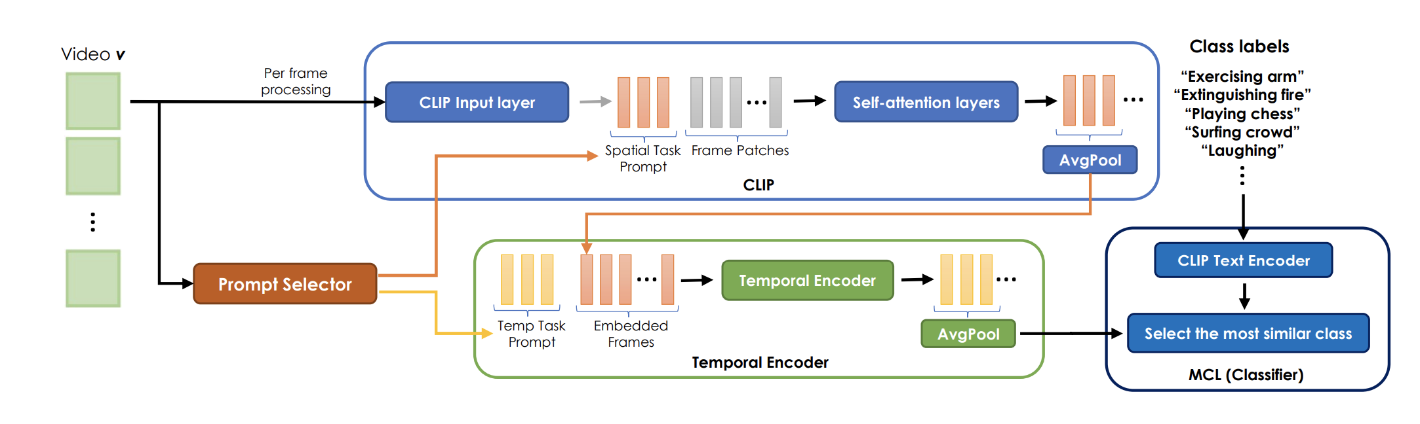
PIVOT – Spatial prompting

Slide 41
PIVOT – Temporal Prompting

Slide 42
PIVOT – Spatial and Temporal Encoding

Slide 43
PIVOT – MultiModal Contrastive Loss

Slide 44
This also Works for Video!
Zero shot provides a fair baseline for continaul learning
But how can it be improved?
Can we use the knowledge on the language stream to tune our classfier in the continual learning setup?

Slide 45
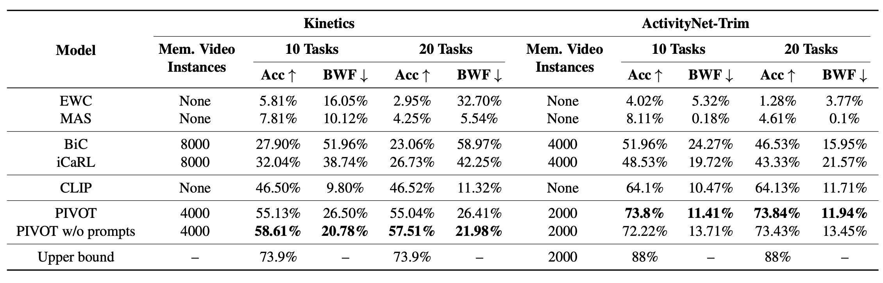
PIVOT Results

Slide 46

Questions?

